Slide 1
System and Network Administration
Core Services:
LDAP

Slide 2
Directory Services
A centralized, structured repository of configuration, authentication and other related information.
Objects can include:
Users
Groups
Servers
Clients
Printers
Network services
Structure is based on a hierarchy of objects.
Starts with root and branches out to other objects.
A network service that stores information about objects in a particular network.

Slide 3
Directory Services
Optimised for high performance query capabilities
Access Control: per record
Optimised for read-only use (not updated during use)
It doesn’t have Relationships (PK <- fk)
It isn’t Transactional
It has poor modification performance
SQL allows complex update and query functions at the cost of program size and application complexity.
Directories use a simplified and optimized access protocol that can be used in slim and relatively simple applications.

Slide 4
The Role of Directory Services
Application settings: Allows applications to query the directory for configuration information
Physical location of application components
Version information for application components
Application’s object definitions
Personal data: Allows people to find information about others
Users, telephone numbers, email, hosts, IP address
Merger of authentication sources
For example, a guard views an employee ID and types the name into a web page. The page calls a CGI program which does an LDAP query, and retrieves the employees picture file. The picture is displayed so the guard can verify the employees identity.

Slide 5
Objects, Attributes, and the LDAP Directory
Real-world objects such as users and computers are represented as objects in the LDAP Directory.
The LDAP Directory supports numerous object types
Each object and object type is represented by a unique global identifier.
Each object has a set of attributes that best describe it. For example, consider a user object. Each user can have attributes such as Name, Address, and Telephone number.

Slide 6
Directory Hierarchy
Develetech
US
Sales
EU
R&D
John
Mary
Marketing
IT
Marcus
CRM Server
Alyssa
Marketing Website
Jeremy
Gloria
Francis
VPN Server
Workstation
Company
Region
Department
Users and Computers

Slide 7
Hierarchical Directory
Well suited to distributed environment: Directory tree may be partitioned into sub-trees with no overlap.
allows delegation of parts to separate hosts.
Cooperating groups can then manage their own data locally and share with others.
May allow Availability and Redundancy through replication of data and service

Slide 8
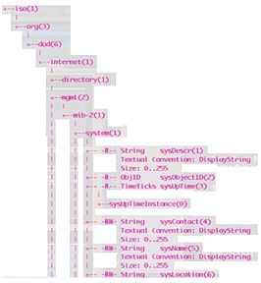
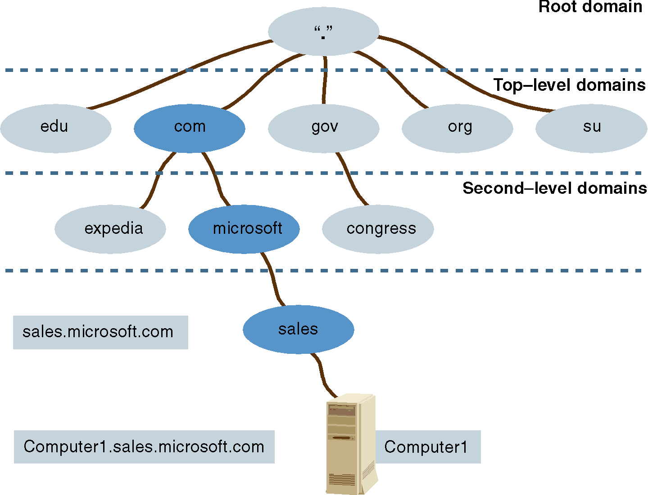
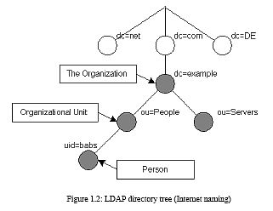
Network Directory Services
DNS
SNMP for system management information
LDAP for organisational information

Slide 9
Common LDAP Directory Services
Directory Service | Description
OpenLDAP | Open source cross-platform LDAP implementation. Included in many Linux distros.
Microsoft Active Directory | Compatible with simplified version of standard LDAP Holds network object info for one or more domains.
Open Directory | Apple's custom implementation of OpenLDAP for macOS. Some compatibility with Active Directory.
Oracle Directory Server Enterprise Edition (ODSEE) | Marketed toward large installations that require reliable scaling. Formerly known as Sun Java System Directory Server.
OpenDJ | Open source cross-platform directory service written in Java. Based on Sun's OpenDS service.

Slide 10
LDAP Directory Services
LDAP is based on the X.500 directory access protocol standard from 1988
First release by developers 1995, first IETF RFC 2002
It has a lot of old-fashioned arcane terminology and an object model from the early days of OO-programming
ASN.1 was originally defined in 1984; XML didn’t come along until 1998, based on SGML (ISO 8879:1986)
Nonetheless, it has been widely adopted and is an essential component of our current enterprise
Microsoft networks rely on Active Directory for almost everything, including DHCP and DNS services, user account management, and security (Group Policy Objects)

Slide 11




Slide 12



Lightweight Directory Access Protocol
LDAP clients authenticate to LDAP service.
Schema defines:
Tasks clients can and cannot perform while accessing directory.
The form a directory query must take.
How directory server will respond.
Schema is extensible.
LDAP Client
Directory query
LDAP Server
LDAP Client
Directory query
Stores directory
data

Slide 13
LDAP: Lightweight Directory Access Protocol
Described in RFC 2251-2256, 2829-2830
Unencrypted access TCP port 389
LDAP-over-SSL LDAPS TCP port 686
Your directory can contain pretty much anything you want to put in it.
Information describing users, applications, files, printers, and other resources accessible from a network
The most typical use is email directories: all the usual mail programs recognize LDAP directories
Easy lookups from scripts:
ldapsearch
Java/Python libraries
Web based tools: phpLDAPadmin

Slide 14
X.400 and X.500
1978: International Standards Organisation (ISO) and International Telecommunications Union (ITU)* began working on standards for network protocols, electronic mail. and directory services
ISO-OSI model was defined, with protocols for the lower layers. Not too popular compared to TCP/IP
1984: X.400 email – was popular for a while, not anymore.
1988: X.500 directory services – considered too cumbersome, but led to Simple Network Management Protocol (SNMP) and Lightweight Directory Access Protocol (LDAP)
* CCITT was the ITU standards committee

Slide 15
X.500 Directory Terms – 1
DIT: Directory Information Tree
Data is represented in the directory as a hierarchy of objects, each of which is called an entry. The DIT is the hierarchy of objects that make up the local directory structure.
The top of the tree is commonly called the root or the base entry
Entry: An object stored in a directory.
Each entry has one parent entry and zero or more child entries
Entries are composed of a collection of attributes that contain information about the object
The information is represented as a value for the attribute.
Attributes and their characteristics are defined in a schema

Slide 16
X.500 Directory Terms – 2
RDN: Relative Distinguished Name
The OID of an entry that is unique at its level in the hierarchy.
DNS equivalent is a partial domain name like .com or .edu.my
DN: Distinguished Name.
Uniquely defines an object and who is responsible for its definition
Comprised of a series of RDNs that uniquely describe the complete path from the DIT root to the entry
DNS equivalent is a FQDN (fully qualified domain name)
OID: Object Identifier
DN represented as a string of numbers delimited by decimals, like 1.3.6.1.2.1.1 which is equivalent to
iso(1) org(3) dod(6) internet(1) mgmt(2) mib(1) system(1)

Slide 17
X.500 Directory Terms – 3
Schema: Defines objects that can be stored in the DIT
Defines where in the DIT structure (hierarchy) objects may appear.
Lists the attributes of each object and whether these attributes are required or optional
Every attribute used must be defined in a schema that is known to the directory server
The data in an entry is contained in attribute-value pairs.
Type of an attribute is commonly used to refer to the ASN.1 SYNTAX of the attribute.
The ASN.1 Syntax specifies what kind of values can be stored in attributes.

Slide 18
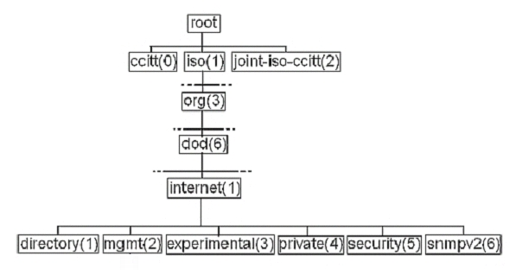
LDAP: Lightweight Directory Access Protocol
When X.500 standard attribute types were defined in X.520, the plan was to use iso(1) org(3) dod(6) internet(1) directory(1) or .1.3.6.1.1 for general information and .1.3.6.1.5 for X.509 certificates
People quickly decided X.500 was too complex, but X.509 and some of the X.520 attributes were useful, so you will see OIDs from everywhere.
LDAP evolved using a separate OID space for types (syntax): .1.3.6.1.4
SYNTAX 1.3.6.1.4.1.1466.115.121.1

Slide 19
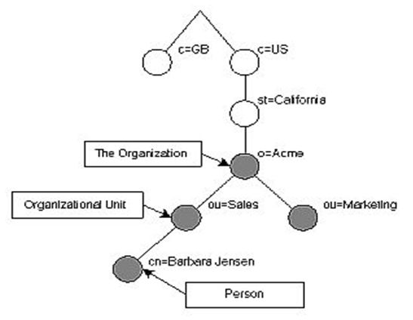
LDAP Naming Model
Entries are named according to their position in the DIT
A RDN is a name=value
A DN is a sequence of RDNs separated by commas
The Organizational Unit sales has the DN ou=sales,o=Acme,st=California,c=us
The entry at the bottom for Person has the DN of
cn=Barbara Jensen,ou=sales,o=Acme,st=California,c=us

Slide 20
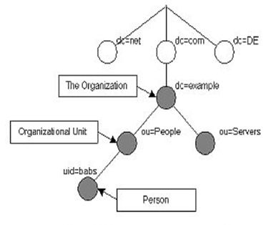
Typical LDAP DITs
Internet
Domain
Traditional

Slide 21
LDAP Functional Model
General interaction between an LDAP client and server:
1. Binding: establishes a session
The client specifies the host name or IP address and port number where the LDAP server is listening.
2. Authentication
Authenticated User: client supplies a DN identifying itself along with a simple clear-text password..
Anonymous User: without username and password.
While plaintext authentication with TLS to encrypt the session is quite common, use of strong authentication is encouraged:
Simple Authentication and Security Layer (SASL) makes several different authentication methods available

Slide 22
LDAP Functional Model
General interaction between an LDAP client and server:
3. Perform Operations:
Search for entries meeting user-specified criteria
Add / Update / Delete an entry
Modify the DN or RDN of an entry (move)
4. Unbind
Close the session with the server

Slide 23
LDAP Queries
The most common operation is search.
To perform a search, the following parameters must be specified:
Base: A DN that defines the starting point, called the base object, of the search. The base object is a node within the DIT.
Search Filter: Specifies the criteria an entry must match to be returned from a search.
The search filter is a Boolean combination of attribute value assertions.

Slide 24
LDAP Queries
The following parameters may be specified:
Scope: Specifies how deep within the DIT to search from the base object.
baseObject: Only the base object is examined
singleLevel: Only the immediate children of the base object are examined, but not the base object itself
wholeSubtree: The base object and all of its descendants are examined
Attributes to Return: from entries that match the search criteria.
Limit: restricts the number of entries returned from the search.

Slide 26
What’s in slapd.conf
OpenLDAP configuration is done via a file called: /etc/openldap/slapd.conf
This is where you specify:
Authentication and TLS
Schema and ObjectClass definitions
include /etc/openldap/schema/core.schema
include /etc/openldap/schema/cosine.schema
include /etc/openldap/schema/inetorgperson.schema
Backend Database options, including indexes and default search base

Slide 27
OpenLDAP Database Tools
Slapadd is used to add entries specified in LDIF to an OpenLDAP database when the slapd daemon is running. Note that it does not perform user and system schema checks – in particular, it does not verify that superior entries exist before adding an entry.
ldapadd is used to add entries specified in LDIF to an openLDAP database when the slapd daemon is not running. It does verification and schema checks.
The -c option to continue in case of a syntax error is highly recommended
To initialise the LDAP database, these tools can be easier to use than web-based tools
Notes:
Here are the steps... line by line... to export the Open LDAP database contents to a text file. Rebuild the database then import the contents from the file. This is useful when inherent corruption of the database cannot be resolved
with a /opt/insight/etc/rc/slapd recover command.
Steps to rebuild LDAP database: # /opt/insight/htdocs/is4web/cron/server-backup_ldap.sh # /opt/insight/sbin/slapcat > /tmp/test.ldif # /etc/init.d/insightserver stop
# ps –ea | grep slapd /* if the slapd process is still running then... */ # killall -9 slapd # cd /opt/insight/var # mv openldap-data/ openldap-data.old # mkdir openldap-data # cd openldap-data.old/ # cp DB_CONFIG ../openldap-data # cd ../openldap-data # /opt/insight/etc/rc/slapd start # cat /tmp/test.ldif |/opt/insight/sbin/slapadd -c # /opt/insight/etc/rc/slapd stop # ps –ea | grep slapd /* if the slapd process is still running then... */ # killall -9 slapd # /opt/insight/etc/rc/slapd recover # /opt/insight/etc/rc/slapd start # /etc/init.d/insightserver start # /opt/insight/sbin/slapindex
Last update: 2005-01-21 12:07

Slide 28
OpenLDAP Database Tools
ldapsearch opens a connection to an LDAP server, binds, and performs a search using specified parameters.
Useful for debugging and in special cases
Generally, other tools are better
phpLDAPadmin
ldapmodify: allows you to batch changes in an LDIF file
The LDIF format can have a changetype: field in the record
add, modify, delete, modrdn
Every change record requires a unique DN
Useful in special cases

Slide 29
OpenLDAP
oops!
password in /etc/openldap/slapd.conf
rootpw <admin password>
Restart slapd
/etc/rc.d/rc.slapd restart
OpenLDAP is “famous” for its obscure error messages
Be sure permissions are set properly on /var/run -
or you will see a famous message when LDAP does not start!

Slide 30
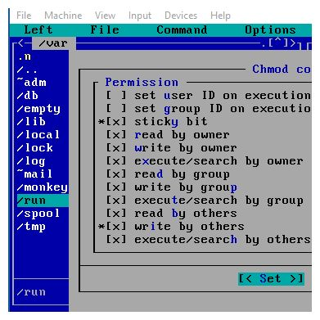
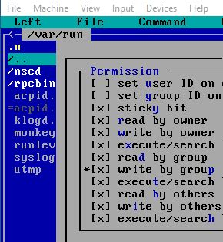


Special Directory Permissions
Sticky Bit (Directory Only):
Anyone can write a file
Only the owner can delete

Slide 32
AAA is an architectural framework for configuring a set of three independent security functions consistently
Authentication: the method of identifying users, including login and password dialog, challenge and response, messaging support, and, depending on the security protocol selected, possibly encryption.
Authorization: the method for access control, including one-time authorization or authorization for each service, per-user account list and profile, user groups, and protocols
Accounting: the method for collecting and sending information used for billing, auditing, and reporting, such as user identities, start and stop times, executed commands, number of packets, and number of bytes.
Guidelines for Placing ACS in the Network 17 Jan 2006
www.cisco.com/en/US/products/sw/secursw/ps2086/products_white_paper09186a0080092567.shtml

Slide 33
SASL and PAM
Simple Authentication and Security Layer (SASL) is a method for adding authentication to connection-based protocols
used when a simple user/password authentication is not enough
protocols supporting SASL include: SMTP, IMAP, POP, LDAPv3 (but not v2)
Pluggable Authentication Modules (PAM) is a method for adding authentication to applications and services
“Plug in” different authentication methods
Different services can have different authentication policies
Most linux distributions are “pam-aware” (compiled with the /usr/lib/libpam.a library) – but ours is not

Slide 34
SASL
Usually used for authentication of systems
For example:
MUA to MSA (webmail to mailserver)
MSA to MTA (mailserver to mailserver)
MTA to MDA (mailserver to IMAP server)
MUA to Directory (webmail to LDAP server)

Slide 35
SASL
A SASL capable protocol includes configuration directives for authenticating a client to a server and for optionally negotiating a security layer
Servers can be configured to negotiate and use possibly nonstandard and/or customized mechanisms for authentication
A challenge/response system is used to get the needed information from the client, up to the point the authentication is either successful or fails.
Usually used for authentication of systems: sasl fills one small gap in our security policy - port 587 authentication
SSH doesn't use SASL because it predates it, and there has not been interest making something that uses SASL and TLS

Slide 36
PAM
There are four groups of PAM modules for independent management:
Account modules check that the specified account is a valid authentication target under current conditions. This may include conditions like account expiration, time of day, and that the user has access to the requested service.
Authentication modules verify the user's identity, for example by requesting and checking a password or other secret. They may also pass authentication information on to other systems or modules.
Password modules are responsible for updating passwords, and are generally coupled to modules employed in the authentication step. They may also be used to enforce strong passwords.
Session modules define actions that are performed at the beginning and end of sessions. A session starts after the user has successfully authenticated.

Slide 37
PAM
Which authentication module is to be used depends on the local system setup and is at the discretion of the local system administrator.
Modules are stacked (order is important)
Sample PAM configuration in /etc/pam.d
interface control flag module name
auth required pam_nologin.so
auth required pam_securetty.so
auth sufficient pam_unix.so
auth required pam_ldap.so
lots of modules are available
http://www.linux-pam.org/modules.html

Slide 38
PAM
Standard Warning:
You can lock yourself out of your own system if you are not careful!
(also applies to SELinux) (next week)

Slide 39
PAM, LDAP and Network Accounts
Local accounts are unique to each host. Changes to an account (e.g., new password) on one host do not affect similar accounts on other hosts
A networked account is a single user identity shared by many hosts. Changes to the account globally affect all other hosts
PAM is required to use a LDAP server to provide user information rather than the local database of users (/etc/passwd and /etc/shadow)
Note:
We see this in system descriptions, so we need to know what it is even if we don’t use it
Notes:
Network Administration - Managing Hosts and Users
12/23/2021
FIT2018 (c) Monash University
39

Slide 40
Scenario
ssh to server, network account
Caught by iptables, source & destination allowed <or>
Caught by tcpwrap, host & service allowed (redundant?)
Caught by PAM, request passed to LDAP client application
LDAP client contacts LDAP server
LDAP server requires SASL authentication before bind
Authentication successful, LDAP server returns username and (encrypted) password
LDAP client passes these back to PAM
Next PAM module verifies credentials
ssh connection is allowed (whew!)

Slide 41
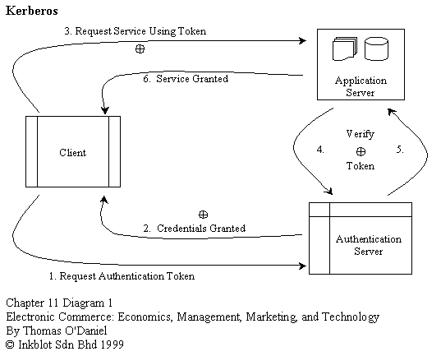
AAA: Kerberos (Microsoft Active Directory)

Slide 42
AAA: RADIUS
Remote Authentication Dial-In User Service (RADUIS)
Industry standard for AAA support, developed at Livingston (now Lucent)
The IETF RADIUS specification (RFC2865) and RADIUS accounting standard (RFC2866) along with RFC2868 (RADIUS Attributes for Tunnel Protocol Support).
Centralised database of user information:
authentication & configuration information
type of service permitted

Slide 43
AAA: RADIUS
RADIUS provides authentication and authorization in a single step.
When the user logs into the network, the Network Access Server (NAS) prompts the user for a username and a password.
The NAS will then send the request to the RADIUS server. The NAS may include a request for access restrictions or per-user configuration information.
The RADIUS server returns a single response with authentication approval status and any related access information available.

Slide 44
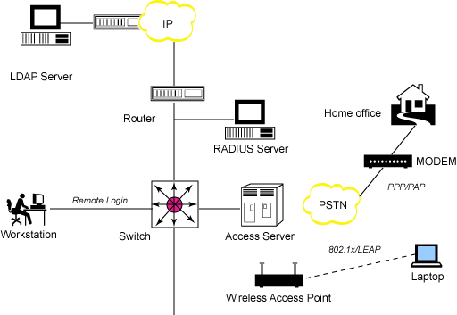
Figure 1. Authentication via RADIUS and LDAP
http://www.ibm.com/developerworks/library/l-radius/

Slide 46
OpenLDAP: Ground up
If you use iptables, open port 389 (636 for ldaps)
iptables -A INPUT -s 198.168.0.0 -p tcp --destination-port 389 -j ACCEPT
iptables -A INPUT -s 198.168.0.0 -p udp --destination-port 389 -j ACCEPT
Configure /etc/openldap/slapd.conf
Build an initial data base
Design a Schema
Find out which apps require what
Design a Tree (DIT)
First you build the base (tags like “C”, “DC”, “O”, and “OU”)
then the branches (the individual “DN” or distinguished names)
then the rest (tags like “address”, “title”, “mail” )
Create an LDIF data file, and populate the LDAP server using the OpenLDAP database tools
Start the slapd service on your machine

Slide 47
LDAP attributetype Definition
OID (Object Identifier)
Always begins with a string of numbers delimited by decimals.
# Sspecifies the favourite drink of an object
# (or person). [cosine schema]
attributetype ( 0.9.2342.19200300.100.1.5
NAME ( 'drink' 'favouriteDrink' )
DESC 'RFC1274: favorite drink'
EQUALITY caseIgnoreMatch
SUBSTR caseIgnoreSubstringsMatch
SYNTAX 1.3.6.1.4.1.1466.115.121.1.15{256} )
Every attribute has one or more NAMEs
In LDAP names are preferred for queries rather than OIDs (opposite of SNMP)
Matching rules: define methods of comparison, e.g., case sensitive or case insensitive. Matching rules are typically built-in to the LDAP server and do not need to be defined explicitly. See OpenLDAP v2.3 Admin.Guide section 9.2
SYNTAX: specifies the data type, e.g., string, number etc.
Every attribute has a data type – See OpenLDAP v2.3 Admin.Guide section 9.2

Slide 48
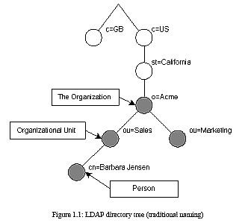
Typical LDAP Schema (1)
attributetype ( 2.5.4.41 NAME 'name'
EQUALITY caseIgnoreMatch
SUBSTR caseIgnoreSubstringsMatch
SYNTAX 1.3.6.1.4.1.1466.115.121.1.15{32768} )
attributetype ( 2.5.4.6 NAME ( 'c' 'countryName' )
DESC 'RFC2256: ISO-3166 country 2-letter code'
SUP name SINGLE-VALUE )
attributetype ( 2.5.4.8 NAME ( 'st' 'stateOrProvinceName' )
DESC 'RFC2256: state or province which this object resides in'
SUP name )
attributetype ( 2.5.4.10 NAME ( 'o' 'organizationName' )
DESC 'RFC2256: organization this object belongs to'
SUP name )
attributetype ( 2.5.4.11 NAME ( 'ou' 'organizationalUnitName' )
DESC 'RFC2256: organizational unit this object belongs to'
SUP name )
attributetype ( 2.5.4.3 NAME ( 'cn' 'commonName' )
DESC 'RFC2256: common name(s) for which the entity is known by'
SUP name )
supports inheritance:
SUP

Slide 49
Typical LDAP Schema (2)
attributetype ( 0.9.2342.19200300.100.1.25
NAME ( 'dc' 'domainComponent' )
EQUALITY caseIgnoreIA5Match
SUBSTR caseIgnoreIA5SubstringsMatch
SYNTAX 1.3.6.1.4.1.1466.115.121.1.26 SINGLE-VALUE )
attributetype ( 2.5.4.10
NAME ( 'o' 'organizationName' )
DESC 'RFC2256: organization this object belongs to'
SUP name )
attributetype ( 2.5.4.11
NAME ( 'ou' 'organizationalUnitName' )
DESC 'RFC2256: organizational unit this object belongs to'
SUP name )
attributetype ( 0.9.2342.19200300.100.1.1
NAME ( 'uid' 'userid' )
DESC 'RFC1274: user identifier'
EQUALITY caseIgnoreMatch
SUBSTR caseIgnoreSubstringsMatch
SYNTAX 1.3.6.1.4.1.1466.115.121.1.15{256} )
Several standard schemas:
core
cosine
inetorgperson

Slide 50
LDAP objectClass
One or more objectClass(es) must be present in an LDAP entry.
Denotes the type of object being represented by a directory entry or record – a set of attributes
listed as must contain (mandatory) and may contain (optional)
An attribute defined in one schema can be used by an objectClass defined in another schema.
An attribute may be optional in one objectClass and mandatory in another
There are a confusing number of pre-defined objectClasses, each of which contains bucket-loads of attributes for almost all common applications. But of course the one you NEED is never defined

Slide 51
LDAP objectClass
An object class is declared as abstract, structural, or auxiliary.
Directory entries are instantiated from structural object classes.
An abstract objectClass is used as a template for creating other object classes.
A directory entry cannot be instantiated from an abstract object class.
Auxiliary object classes provide a method for extending structural object classes without having to change the schema definition of a structural class.
An auxiliary object class cannot be instantiated by itself as a directory entry;
There are some objectClasses and attributes defined as operational which are embedded in the LDAP server software and do not need definition.

Slide 52
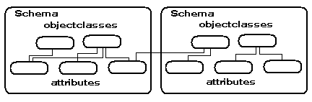
LDAP objectClass Definition
objectclass ( 0.9.2342.19200300.100.4.13 NAME 'domain'
SUP top STRUCTURAL
MUST domainComponent
MAY ( associatedName $ organizationName $ description $ businessCategory $ seeAlso
$ searchGuide $ userPassword $ localityName $ stateOrProvinceName $ streetAddress
$ physicalDeliveryOfficeName $ postalAddress $ postalCode $ postOfficeBox
$ streetAddress $ facsimileTelephoneNumber $ internationalISDNNumber
$ telephoneNumber $ teletexTerminalIdentifier $ telexNumber
$ preferredDeliveryMethod $ destinationIndicator $ registeredAddress
$ x121Address ) )
objectclass ( 0.9.2342.19200300.100.4.15 NAME 'dNSDomain'
SUP 'domain' STRUCTURAL
MAY ( ARecord $ MDRecord $ MXRecord $ NSRecord $ SOARecord $ CNAMERecord ) )

Slide 53
OpenLDAP and LDIF
The LDIF format is unusual, it makes use of tags, but is also position sensitive
Each line begins with a tag, then a full colon, then ONE space, then data
A space in column one denotes a continuation of the previous line
Tabs are forbidden, and be very careful about errors like alphas in numeric fields
OpenLDAP is obnoxiously unforgiving of syntax errors
Error messages are sparse and cryptic, if you get them
Beware of trailing spaces ...

Slide 54
Build the database: LDIF
LDIF (LDAP Data Interchange Format)
RFC 2849 documents the format and fields
LDIF files are simple text files
Can be created and edited with any suitable text editor.
LDIF files are used in five general cases:
To initially construct the DIT structure.
To add (import) bulk records into a directory.
To restore (import) a directory.
To archive (export) a directory.
To apply bulk edits to a directory.

Slide 55
LDIF: Begin with base entries
dn: o=stooges
objectClass: top
objectClass: organization
o: stooges
description: The Three Stooges
dn: cn=Manager,o=stooges
objectclass: organizationalRole
cn: LDAP Directory Manager
dn: ou=MemberGroupA,o=stooges
ou: MemberGroupA
objectClass: top
objectClass: organizationalUnit
description: Members of MemberGroupA
dn: ou=MemberGroupB,o=stooges
ou: MemberGroupB
objectClass: top
objectClass: organizationalUnit
description: Members of MemberGroupB
operational
Each LDIF record begins with a unique DN (usually a “common name” + the Parent DN), followed by several data elements.
objectClass: top
is not defined in the schemas, but everything else is
structural
DN
RDN
http://www.yolinux.com/TUTORIALS/LinuxTutorialLDAP.html

Slide 56
LDIF: Continue with detail entries
DN
dn: cn=Moe Howard,ou=MemberGroupB,o=stooges
o: stooges
ou: MemberGroupA
cn: Moe Howard
objectClass: top
objectClass: person
objectClass: organizationalPerson
objectClass: inetOrgPerson
givenname: Moe
sn: Howard
homePhone: 800-555-1313
telephoneNumber: (800)555-1213
mobile: 800-555-1318
title: Development Engineer
manager: cn=Larry Howard,ou=MemberGroupA,o=stooges
uid: moe
userPassword: moesecret
mail: MHoward@isp.com
RDN
Defined before
RDN
RDN
Defined here
Defined somewhere
DN
For the email account
http://www.yolinux.com/TUTORIALS/LinuxTutorialLDAP.html

